Slide 1
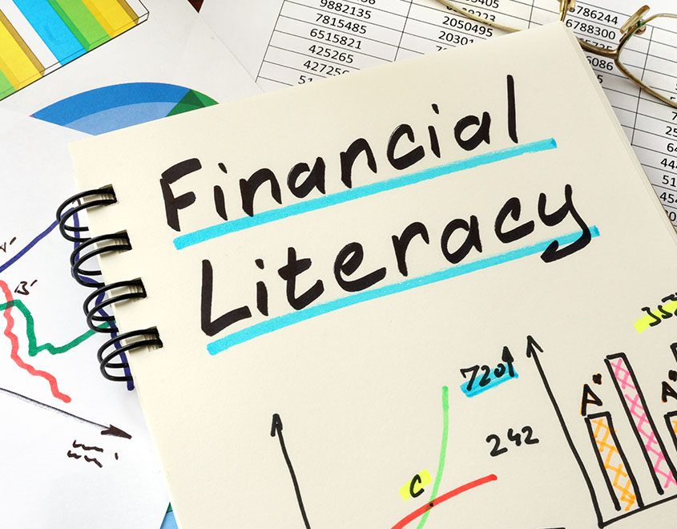

Slide 2

Financial literacy means having the knowledge and skills to manage your money wisely. It’s about understanding how money works- how to earn it, save it, invest it, and make smart decisions so you can reach your financial goals.

Slide 3

WHY IS IT IMPORTANT?
Helps You Make Smart Money Choices
Being financially literate means you can make informed decisions about how to manage your money. Without this knowledge, people might end up spending more than they earn, getting into debt, or missing out on opportunities to save and invest.

Slide 4

Prepares You for Financial Independence
As you grow older, you'll need to handle your own finances. Learning about financial literacy at 18 gives you the skills to manage bills, rent, savings, and investments without depending on anyone else.

Slide 5

Reduces Financial Stress
Knowing how to handle money reduces the anxiety that comes with bills, debt, and financial decisions. When you understand the basics of managing your finances, you feel more in control and confident about your financial situation.

Slide 6
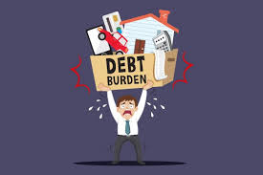
Helps You Avoid Debt Traps
Without financial literacy, it's easy to get into debt by using credit cards or taking out loans irresponsibly. A solid understanding of how interest works and how to avoid overspending helps you stay out of debt.

Slide 7

Allows You to Build Wealth Over Time
Understanding the basics of investing can lead to long-term wealth creation. Small, smart decisions made early in life (like saving a portion of your income or investing in stocks) can pay off big later.

Slide 8

Improves Your Future Opportunities
Financial literacy opens doors. Whether you want to buy a house, start a business, or travel, having a solid understanding of money helps you plan and achieve these goals.

Slide 9

CORE CONCEPTS
Earning and Income Understanding how to make money is the first step. Whether it’s through a job, side hustle, or investments, knowing where your income comes from and how much you can earn is essential for managing your finances. Why it matters: The more you learn about different ways to earn money, the more options you'll have for financial success.

Slide 10

Budgeting and Money Management Budgeting is the process of tracking your income and expenses, so you know exactly where your money is going. A budget helps you avoid overspending, plan for savings, and make sure you’re not living paycheck to paycheck. Why it matters: Without a budget, it’s easy to lose track of your spending and end up in debt. A budget lets you control your money instead of letting it control you.

Slide 11

Basic Budget Example
Income: Rs.10,000
Expenses:
Rent: Rs.3500
Food:Rs.2000
Entertainment: Rs.1000
Savings: Rs.2500
Remaining: Rs. 1000

Slide 12
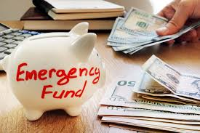
Saving and Emergency Fund Saving is setting aside money for future needs. An emergency fund is a specific amount of money set aside to cover unexpected expenses, like medical bills or car repairs. Why it matters: Life is unpredictable. If something unexpected happens (like losing your job or needing emergency medical care), you won’t have to rely on credit cards or loans to cover it.

Slide 13
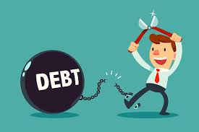
Debt Management and Credit Understanding the difference between “good” and “bad” debt is important. Good debt can help you build your credit or fund investments (like student loans or a mortgage), while bad debt (like credit card debt) can cost you a lot of money in interest. Why it matters: Mismanaging debt can lead to financial struggles and hurt your credit score. Knowing how to manage it, including paying it off on time, ensures you can access better financial opportunities later.

Slide 14

Investing for the Future Investing is putting your money into things like stocks, bonds, or real estate with the goal of making a profit. Understanding the basics of investing (like risk, returns, and diversification) can help you grow your wealth. Why it matters: Investing can help you achieve long-term goals like buying a house, paying for college, or retiring comfortably. Starting early means you’ll have more time for your investments to grow.

Slide 15

Taxes and Withholdings Taxes are the money you pay to the government, usually taken from your paycheck. Understanding taxes, how they work, and how to file your tax return will save you headaches later on. Why it matters: The more you earn, the more taxes you’ll pay. Financial literacy helps you plan for these taxes so they don’t surprise you.

Slide 16
Real-Life Impact of Financial Literacy:
Better Decision-Making: Financial literacy helps you make smart choices, whether it’s about buying your first car, renting an apartment, or taking on student loans.
Financial Freedom: When you understand money, you can create financial goals and work toward them. The more you manage your money well, the more freedom you have to do what you want in life.
Confidence in the Future: As you understand how to save, invest, and manage debt, you'll feel more confident about your financial future, knowing you're prepared for whatever comes your way.

